Slide 1
PRESENTATION ON
Da-lal( A platform which connect everyone serving development of sustainable world)
By : Himesh Rana

Slide 2
PROBLEM
A BIG GAP
GAP`between SUPPLY & DEMAND
GAP between CUSTOMER & SERVICE PROVIDERS
GAP between REVENUE MANAGEMENT SYSTEM.
GAP between BROADER REACH OF SMALL WASTE BUSINESS DIRECTLY TO THE BIG INDUSTRIES OR FIRMS

Slide 3
SOLUTIONS
WEB PORTAL who fill’s all the GAP
Fulfil SUPPLY & DEMAND, So that all the waste should be recycle.
Building trustworthy and respectful platform for CUSTOMERS & SERVICE PROVIDERS.
A REVENUE BOOSTER for all, by eleminating all the offline commission settlers or mediators, and helps to run the chain smoothly.
Helping the small scrap collectors to earn better and eliminating neglection of metric tonns of waste BIG BOOM TO THE INDUSTRY.

Slide 4
FACTS & FIGURES ABOUT SCRAP INDUSTRY
According to a report by SWACHH BHARAT MISSION, URBAN INDIA generates 1.45 LAKHS TONNES per day of MUNICIPAL SOLID WASTE, of which only 23% is processed or treated. The bulk of it, 72% is landfilled.
According to the FEDERATION OF INDIAN CHAMBERS OF COMMERCE (FICCI), the opportunity for the circular economy the system of resource utilization through REUSE and RECYCLING, in INDIA will be worth $500 billion by 2030.
More ENTREPRENEURS are entering this space which has traditionally face Transparency Issue, a demand & supply mismatch, lack of source segregation.
Nearly 95% of recycling is done by the informal market.

Slide 5
Continue..
Many Japanese, American and European investors in China have announced exit from China since Covid-19 pandemic first came into light in November 2019 in Chinese city of Wuhan.
The Indian government is weighing all possible options to attract these investments into the country.
Indian plastic exporters have received an upsurge in orders from the United States, Japan and European countries since the Covid-19 pandemic spread over four months ago.
But, their execution has become a big problem due to closure of manufacturing plants, transportation and shipping to overseas following nationwide lockdown which started from March 25 for three weeks initially and extended for 19 days and further by 14 days.

Slide 6
Product / Processing of the application or online portal
BROWSE NEARBY SCRAP COLLECTORS
SELECT BY CHECKING AUTHENTICITY
CONFIRM THE SERVICE AND COLLECT SCRAP
SELLING A HUGE BULK OF SCRAP TO THE COMPANIES TO RECYCLE OR TO REUSE
CHARACTERIZE ACCORDING TO THE NEED OF PARTICULAR WASTE
SCRAP COLLECTED IN THE SMALL/ LARGE SCRAP FIRMS

Slide 7
Business Model
B2B:
THIS WILL BE OUR MAIN COMPONENT PURCHASING SCRAP IN BULK FROM SMALL/ LARGE SCRAP SHOPS. AND SELLING THEM ACCORDING TO THEIR DEMAND OR THEIR CHARACTERSTIC, GENERATE HUGE REVENUE.
B2C:
FOR THIS BUSINESS MODEL SHOULD BE “REVENUE GENERATING THROUGH CHARGING SOME PERCENTAGE OF REVENUE THOURGH OUR WEBSITE OR OUR APP.
REVENUE BASED ON TWO MODELS

Slide 8
Market Size (IN INDIA):
INDUSTRY GROWING RAPIDLY
$22 BILLION
(As per 2019-20)
$11 billion+$10 billion
(Ferrous+ Non- Ferrous)
$ 500 BILLION
GLOBALLY
95%
Industry work offline
Source: business standard published article.
HUGE POTENTIAL FOR ONLINE MARKET GROWTH

Slide 9




Competition: NONE OF THEM IS GIANT IN THE INDUSTRY. BUT THEY ALL ARE GETTING GOOD RESPONSE FROM AREA THEY SERVED.
ENGAGING
Da-lal APP
MODERN WAYS
( PROMOCODE, SHOPPING VOUCHERS ETC)
TRADITIONALLY WORK
( PAYMENT DIRECTLY IN HAND)
UNAPPEALING

Slide 10
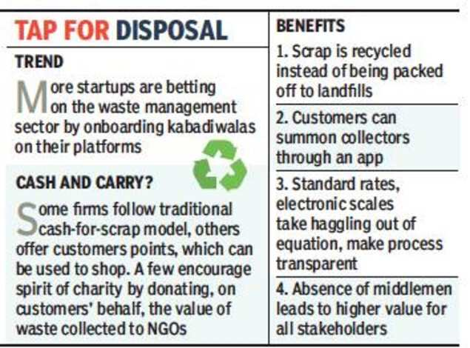
Principles to follow:

Slide 11
Funding:
Really work hard and smart to build this masterplan. 100% sure, we will be successful in this work together. Your little support will help us to achieve huge profit. Best time to execute this plan. So, be quick in taking smart decision.This is definitely be the future call.
Seeking a little amount of investment for the execution: UNDER THE CATEGORY OF VISA WAIVER PROGRAM

Slide 12
Key points ( Future will ours) / Summary :
SUSTAINABILITY IS FUTURE.
SCRAP ANY WASTE OR E-WASTE.
SWITCHING TO E-CARS.
PEOPLE SWITCHING TOWARDS ECO-FRIENDLY PRODUCT. OR SUSTAIN WASTE PRODUCT.
BEST TIME TO START.
KNOWLEDGE ABOUT WASTE IS THE KEY TO SUCCESS.
BEING MEDIATOR IN ANY FIELD IS ACHIEVING HYPE.
MORE AND MORE STARTUPS ARE BETTING IN THIS INDUSTRY.

Slide 13
Conclusion
In conclusion, I would like to say the profit in his industry is immense. It’s our way that how uniquely and broadly we adapt this industry. And this is the best time to adopt this trend. For being a giant in his industry either by building connections or by our strategies or unique plans.
Not only in India, but the trade of recycling is also increasing rapidly in all countries because it will be possible for the human race to survive in the future. If we talk about business, nowadays many companies are earning billions of rupees. Investment from the top is also very less. If you want, adopt this business because, in this nature, you and the people benefit all three. Apart from this, the recycling business is growing well all over the world, so it is safe to invest in this business.

Slide 14
THANK’S A LOT
FOR GIVING YOUR PRECIOUS TIME AND KEEP EYE ON IT

